Slide 1



Seazone
View in Power BI
Last data refresh:
15/03/2022 22:15:05 UTC
Downloaded at:
27/03/2022 02:35:03 UTC

Slide 2
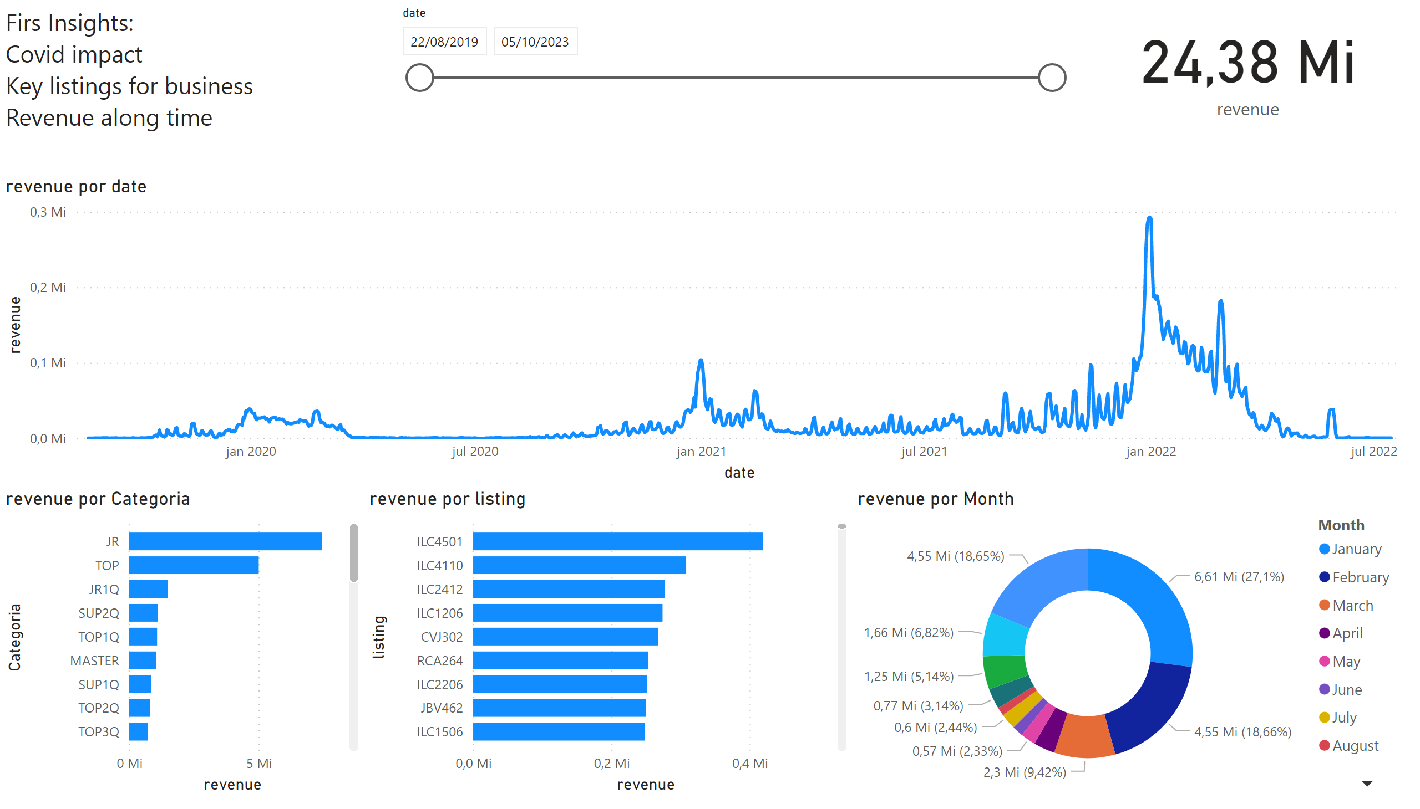
Revenue
Notes:
barChart
No alt text provided
card
No alt text provided
lineChart
No alt text provided
slicer
No alt text provided
barChart
No alt text provided
donutChart
No alt text provided
textbox
No alt text provided

Slide 3
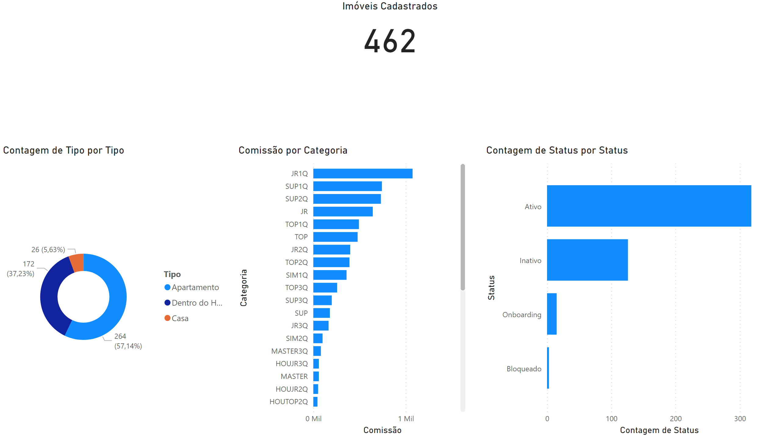
Listings
Notes:
Imóveis Cadastrados
No alt text provided
barChart
No alt text provided
barChart
No alt text provided
donutChart
No alt text provided

